Slide 1
ALL IN ONE TUITION
GUIDED by:- DR. PREMAL SHAH
DESIGNED by:- AAQUIB KHAN

Slide 2
Defination
Website on Online Tuition Classes
Introduction :-Online tuition is a kind of e-learning that takes place over the internet with live interaction between tutors and one or more students

Slide 3
Scope
The online Tuition classes will consist a web based platform.

Slide 4
Requirement Analysis
Admin:-
Admin can manage classes [insert,update,delete]
Admin can manage Students[insert,update,delete]
Admin can generate Fees Receipt
Admin can check how many Students have been Enrolled
Admin can view reports

Slide 5
Reports
Student details
Student enrollment reports month-wise
Classes record
Student record Classes -wise

Slide 6
Students
Can do registration
Can login
Can view Courses
Can select couses
Can manage Courses
Can logout

Slide 7
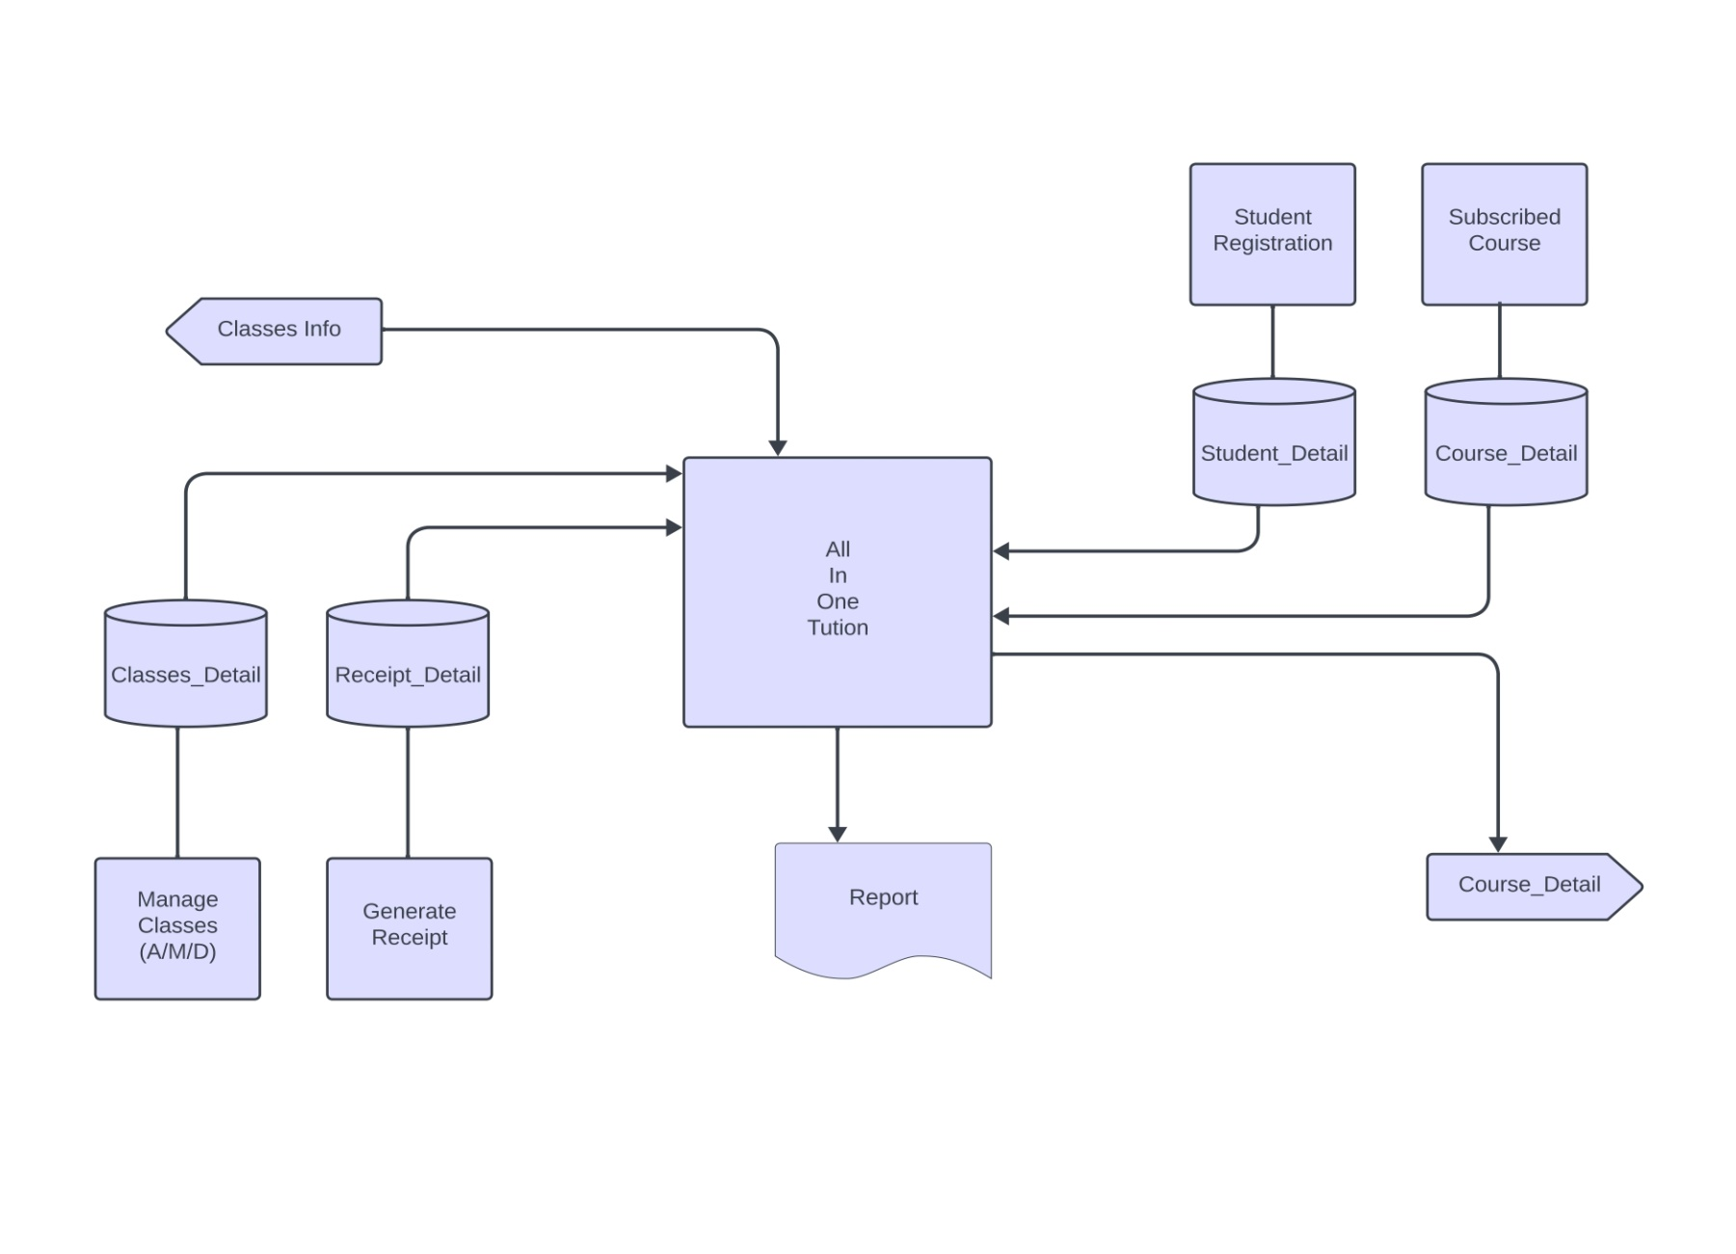
System Flow Diagram

Slide 8
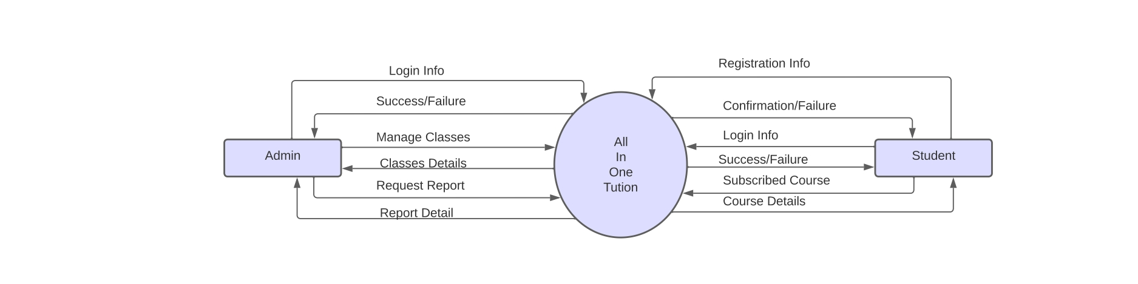
0-Level DFD

Slide 9
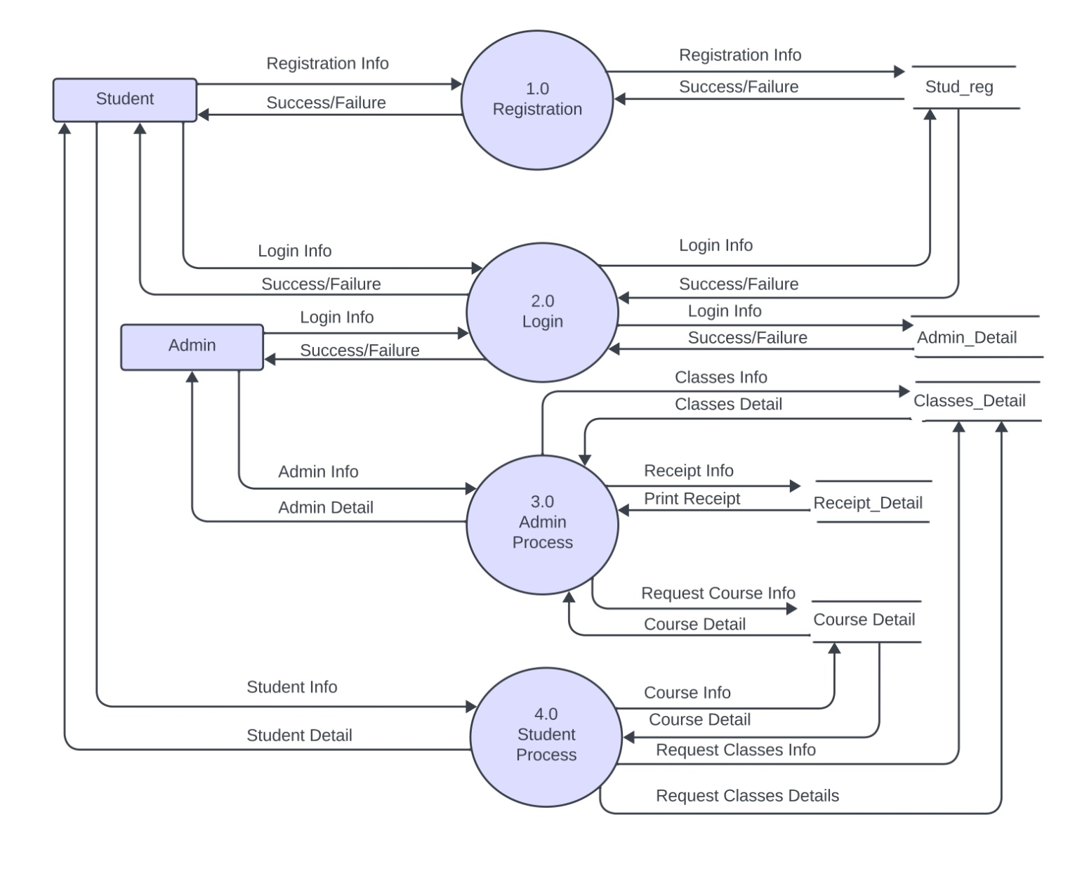
1-Level DFD

Slide 10
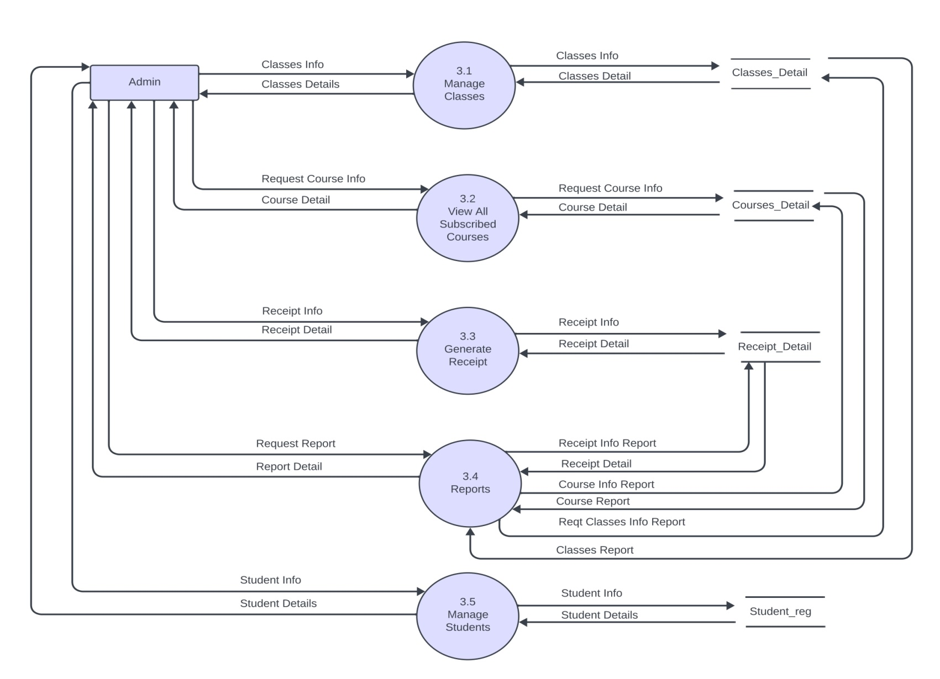
2-Level DFD For 3.0

Slide 11
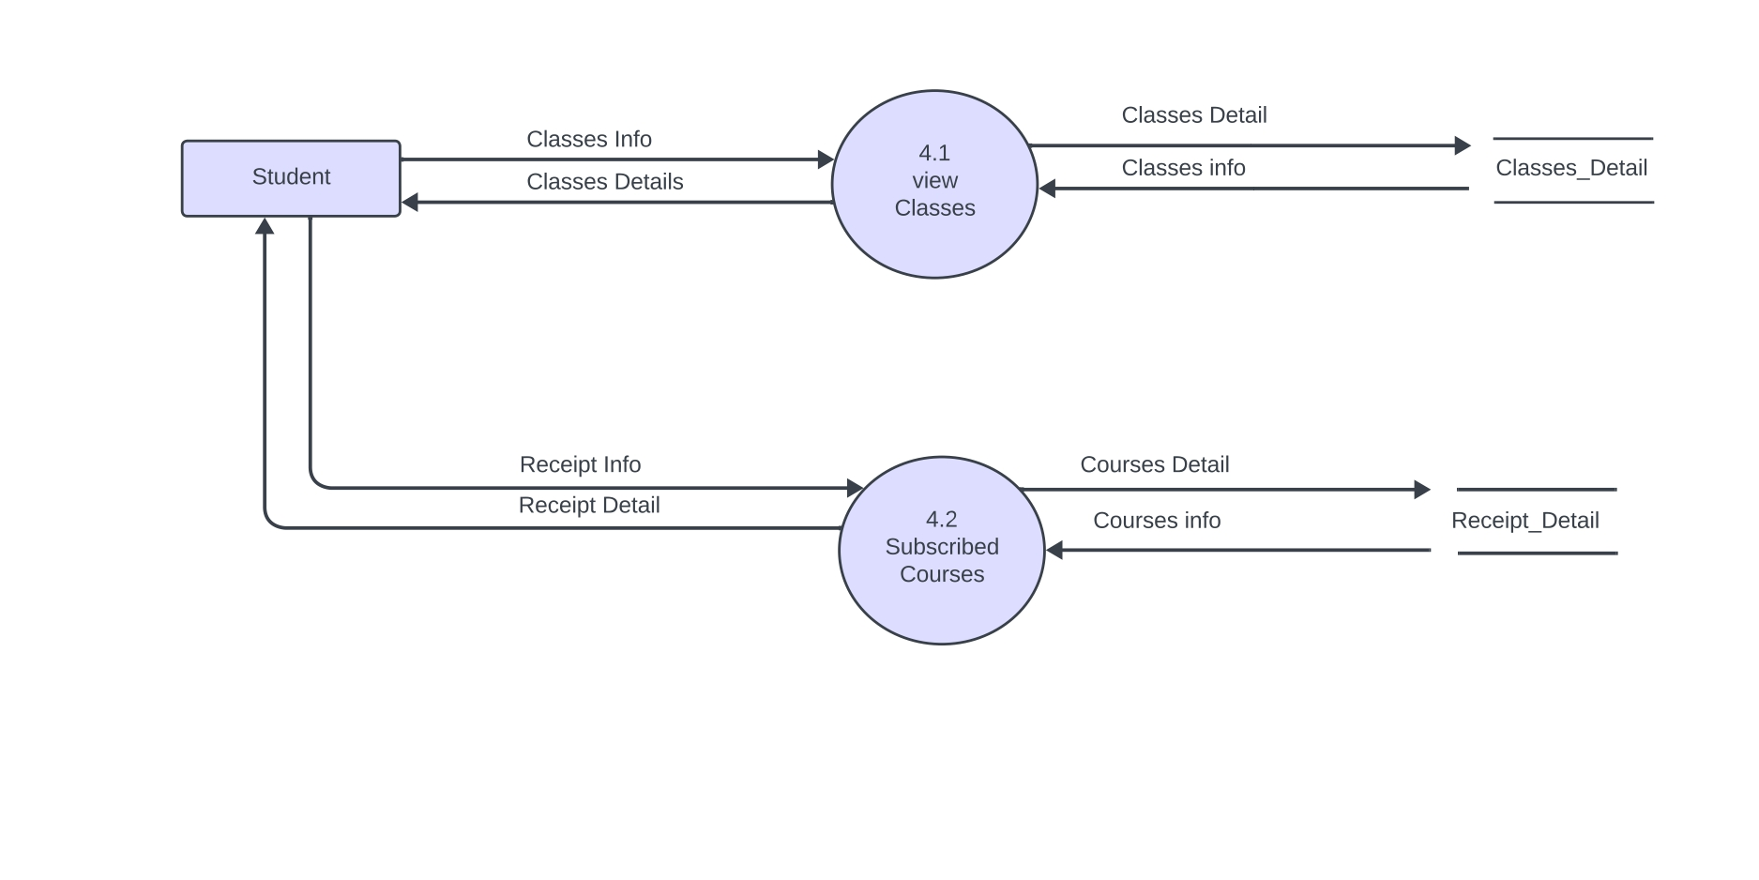
2-Level DFD For 4.0

Slide 12
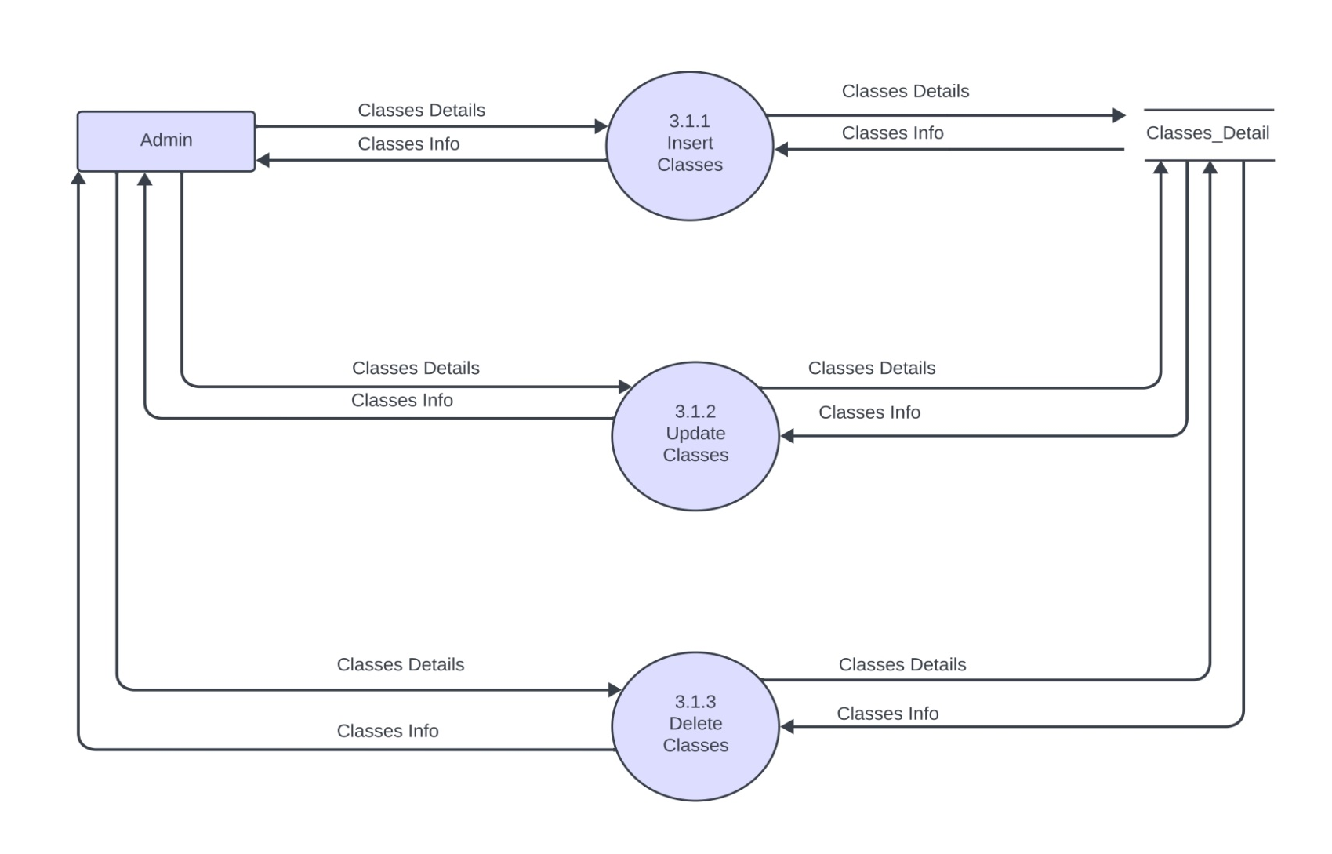
3-Level DFD For 3.1

Slide 13
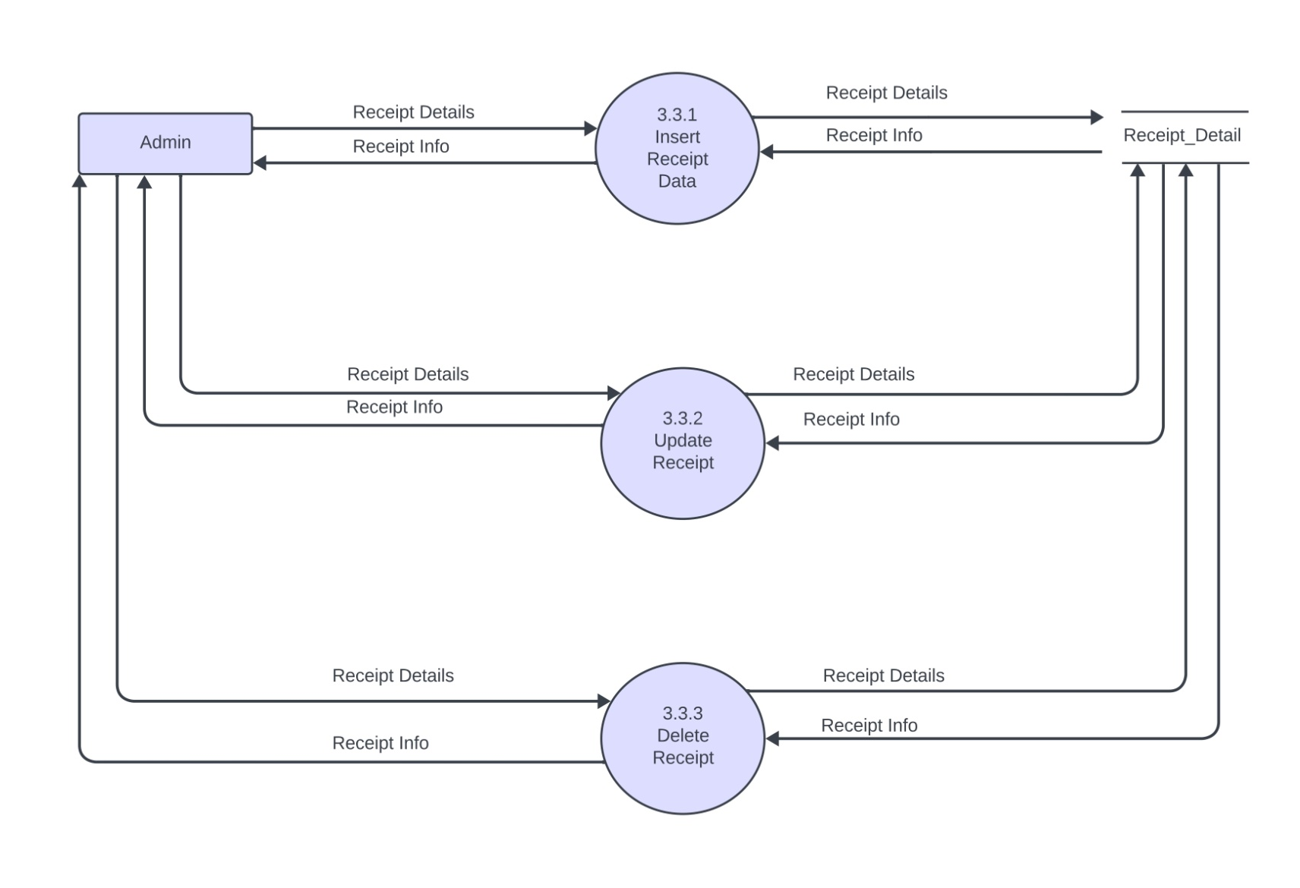
3-Level DFD For 3.3

Slide 14

3-Level DFD For 3.5

Slide 15
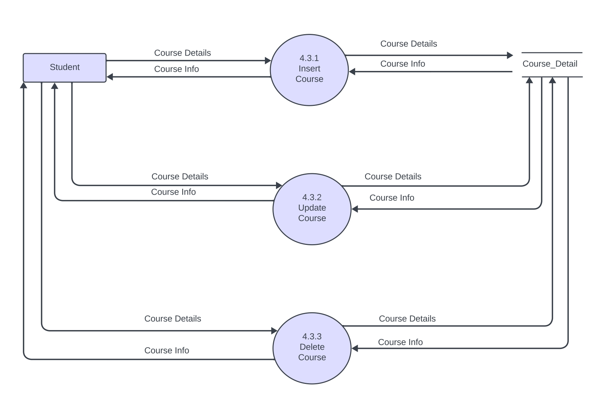
3-Level DFD For 4.3

Slide 16
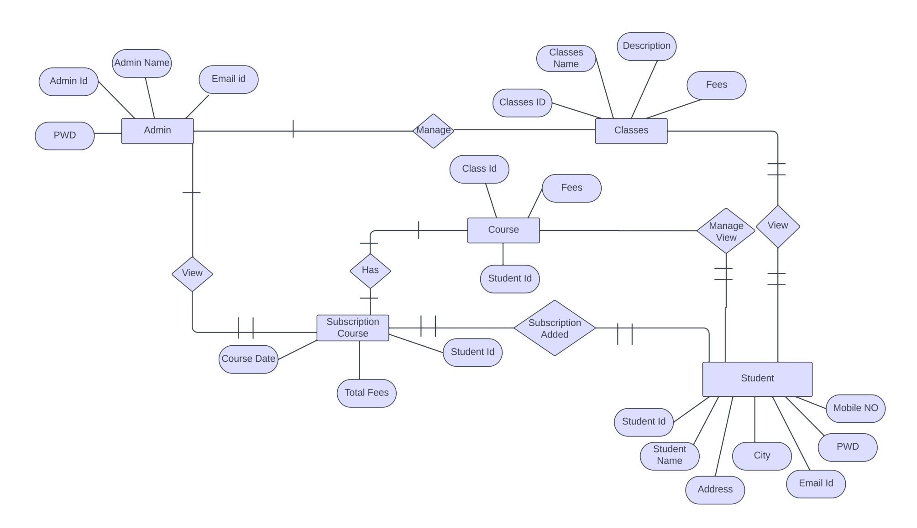
ER Diagram

Slide 17
Data Dictionary
Customer Registration :-
Constraint | Field Name | Data Type | Size | Description
Not Null | Stud_id | Int | 5 | Stud_id For Student
Not Null | Stud_name | String | 20 | Stud_name for Student Name
Not Null | Address | String | 40 | Student’s Address
Not Null | City | String | 10 | Student’s City
Not Null | Mob_no | int | 10 | Student’s Mobile No.
Primary Key | Email ID | String | 20 | Student’s Email ID
Not Null | Password | String | 10 | Student’s Password

Slide 18
Classes Details :-
Constraint | Field Name | Data Type | Size | Description
Primary Key | Classes_name | String | 15 | For Classes Name
Not Null | Description | String | 50 | For Classes Description
Not Null | Fees | int | 4 | For Classes Fees

Slide 19
Course Details
Constraint | Field Name | Data Type | Size | Description
Primary Key | Course_ID | Int | 3 | Course_ID For Classes
Not Null | Course_date | String | 10 | Course_date For Classes
Not Null | Total_fees | String | 4 | Total_fees For Classes
Foreign Key | Stud_id | int | 5 | Stud_id For Student

Slide 20
Receipt Details
Constraint | Field Name | Data Type | Size | Description
Primary Key | Receipt_ID | Int | 3 | Receipt_id For Classes
Foreign Key | Course_ID | Int | 3 | Course_ID For Classes
Not Null | Receipt_date | String | 10 | Receipt_date For Classes
Not Null | Stud_fees | Int | 4 | Stud_id For Student
Not Null | Fees_receipt | String | 4 | Fees_receipt For Classes

Slide 21
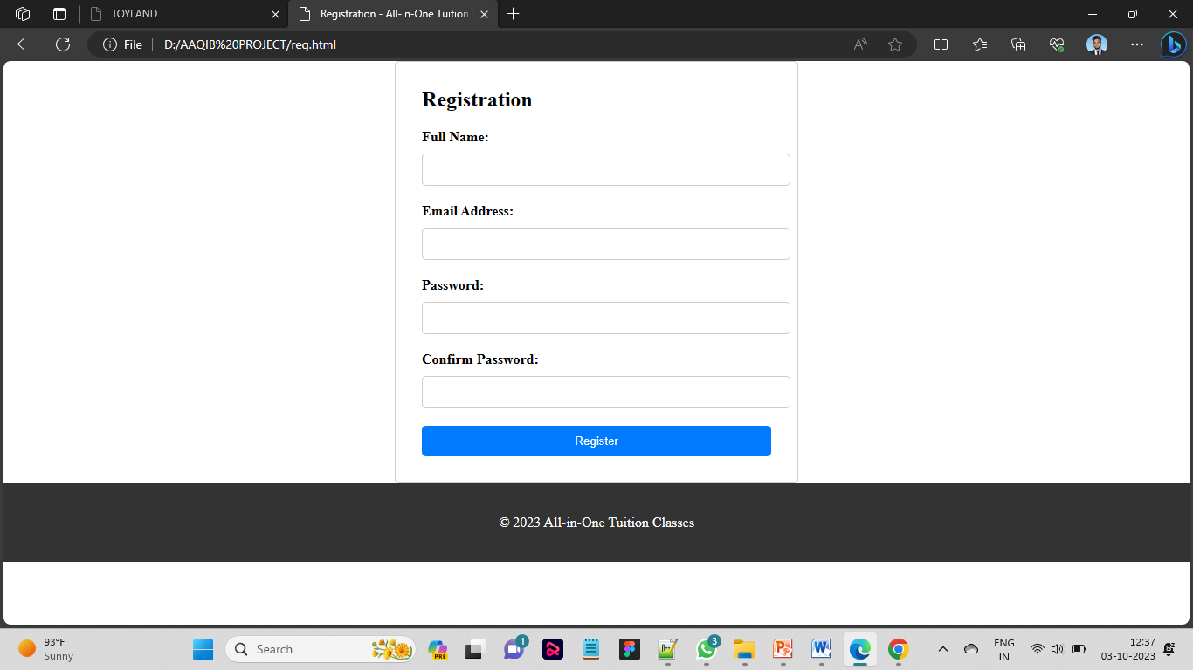
Registration Page

Slide 22
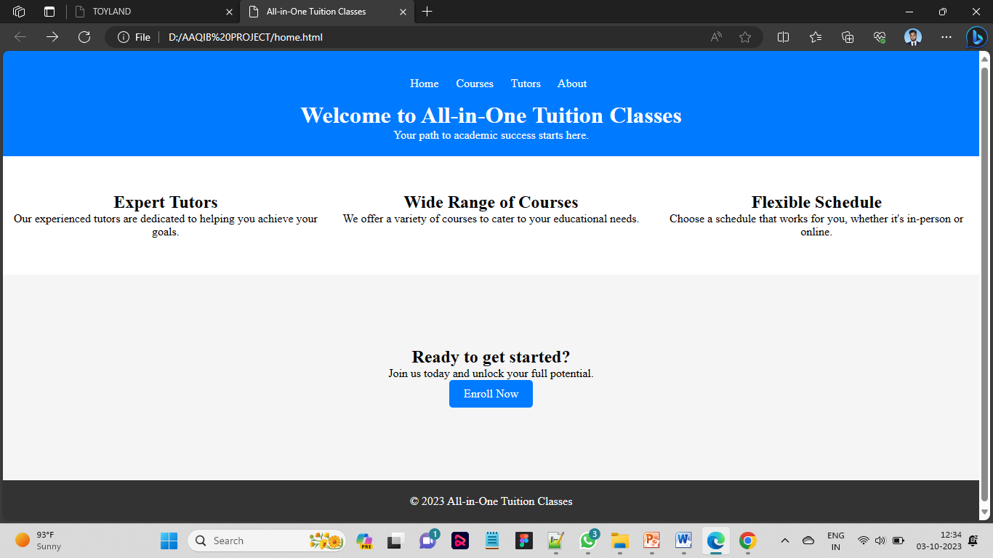
Home Page

Slide 23

About Page

Slide 24
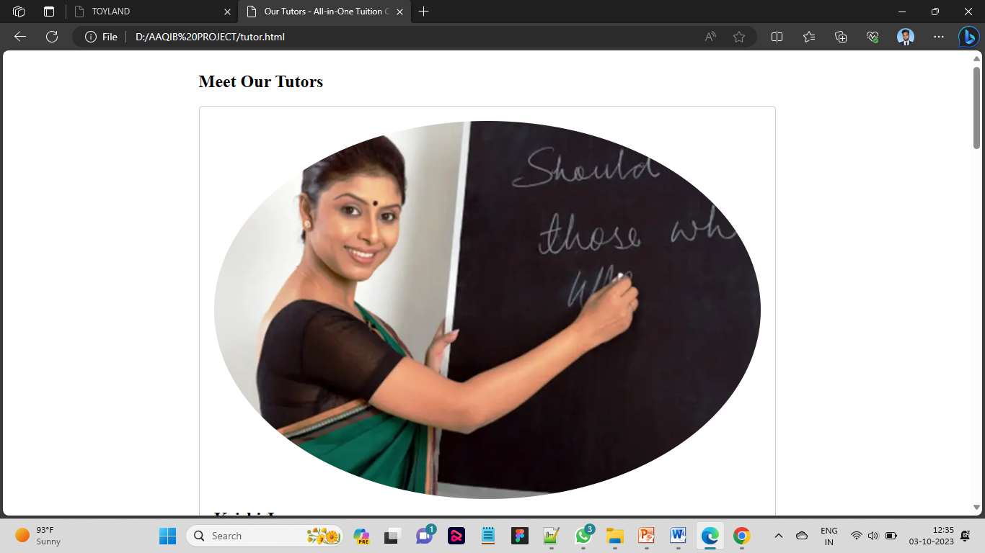
Tutor Page

Slide 25

Courses Page

